Slide 1

TEXT HISTORY EDITOR
Supriya Narravula
Ibm frontend-react

Slide 2
Contents
Introduction
Output screens
What is used

Slide 3
Introduction What is text history editor
A text editor is a tool for editing text.
A text editor's primary purpose is making it easier to work with text.
Code is also text.

Slide 4

Difference
A text history editor is different from a general text editor.
In a normal text editor, we can write, style and do different edits on the text.
But in a text history editor, the editor will make it easy for the user to keep track of their text.
That is done by providing line numbers to the text and it will save the date and time the user edited the text.

Slide 5
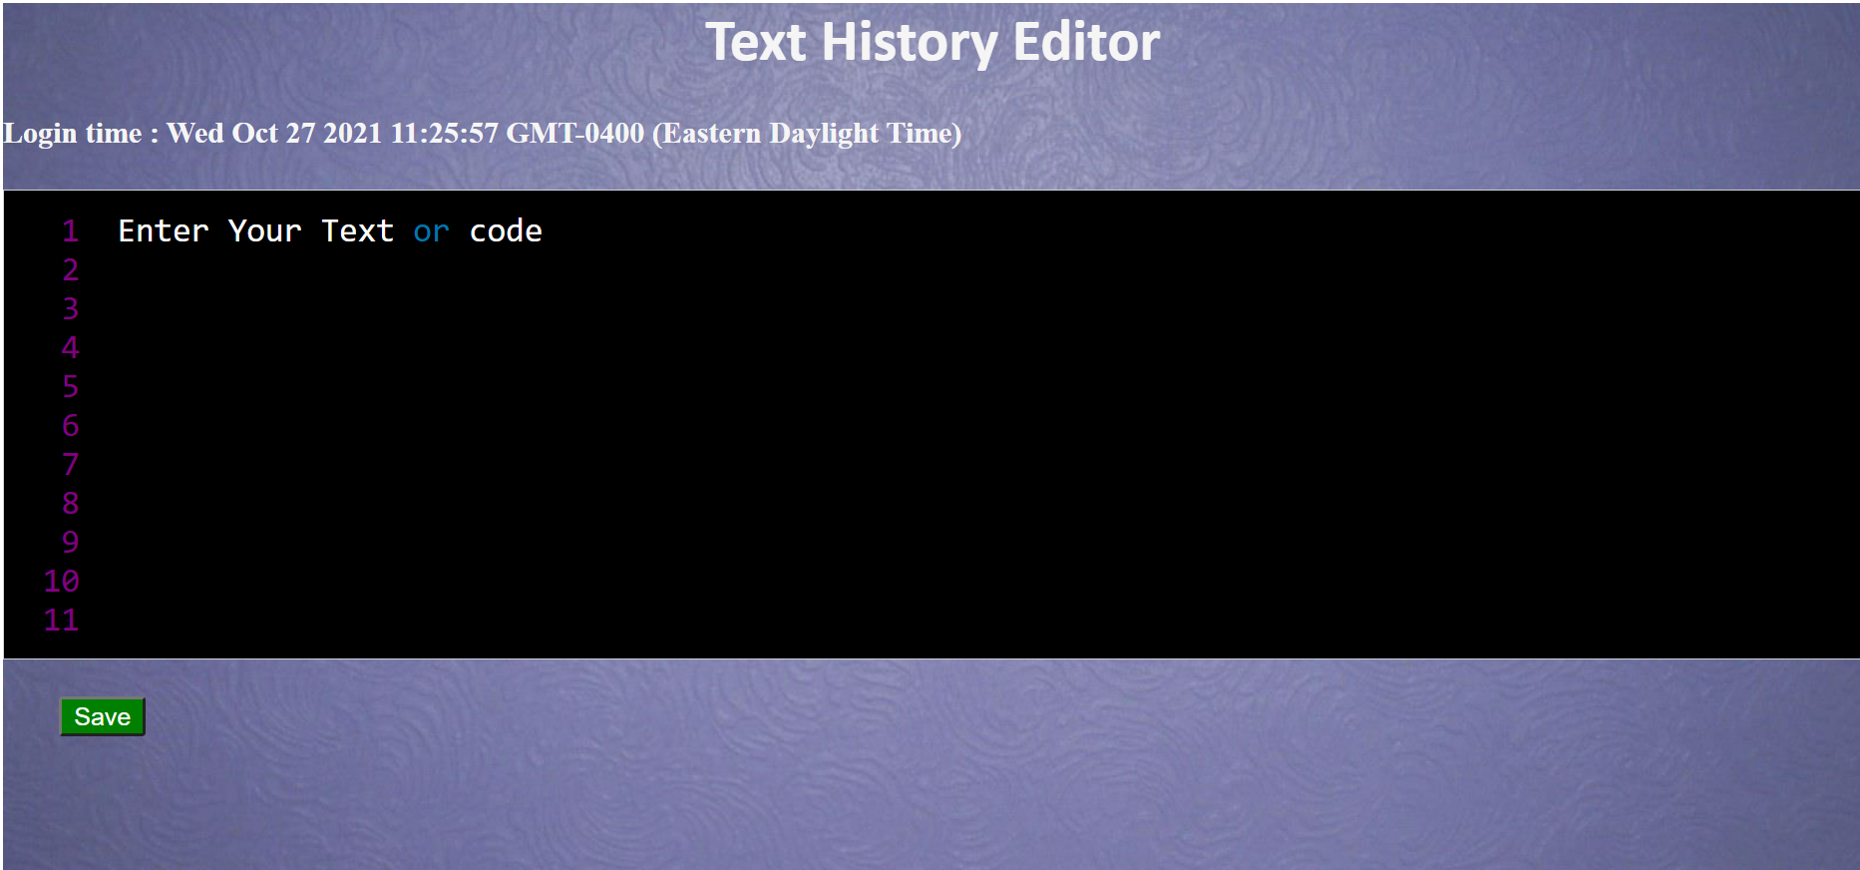
Editor

Slide 6
What can be done?
In the editor, the user can enter their text.
User can add number of lines of text as needed.
Code can also be entered in the editor as it also provides syntax highlighting.

Slide 7
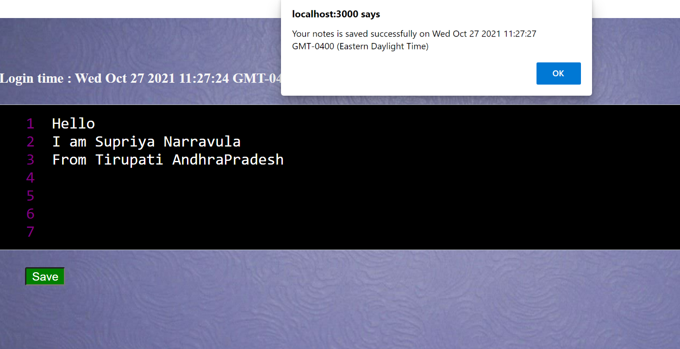
Save

Slide 8
After editing the notes, the user can save the notes by clicking on the save button.
On click of Save, it will display an alert showing the date and time it is saved and get stored in local storage.

Slide 9
What I have used
I have used prismjs to create the editor.
The prismjs provides the line-numbers,syntax highlighting.
And I have used Date() method to display date.

Slide 10


